Slide 1

Department of Cyber Security
2026-2027- Odd Semester
III Year /V Sem
CS23533-FOUNDATIONS OF ARTIFICIAL INTELLIGENCE
Adversarial State-Space Optimization in Chess Environments
Review 1 – 25.09.2026
Baviri Setty Sai Deevan (241901016) | Monish Priyan M (241901057)
Supervisor: Dr. S. Bhuvana, Assistant Professor [SG]
Rajalakshmi Engineering College,Department of Cyber Security

Slide 2
Introduction
2
The project builds a chess-playing agent that treats chess as a fully observable, deterministic, zero-sum adversarial state space.
A goal-based intelligent agent formulates the board as states, legal moves as actions and move execution as the transition function.
Decisions come purely from classical AI search and a hand-crafted heuristic — no machine learning, neural networks or external datasets.
For every position the engine outputs the best move with transparent telemetry: search depth, nodes expanded and evaluation score.
A working prototype is live at foai-chess-engine.web.app — it runs entirely in the browser, with no install and no server.
TASK ENVIRONMENT (AIMA)
Observable
Fully observable
Agents
Multi-agent (competitive)
Deterministic
Yes — no chance element
Episode
Sequential
Dynamics
Static (semi-dynamic with a clock)
State / Actions
Discrete
Department of Cyber Security | Project Review – 1 | 2026–2027

Slide 3
Problem Statement
3
Chess has an enormous game tree, so exhaustive search is impossible and plain Minimax reaches only a shallow depth in practical time.
Depth-limited search suffers from the horizon effect — evaluating a position in the middle of a capture sequence gives misleading scores.
Without move ordering and position caching, Alpha-Beta pruning is inefficient and the same positions are searched repeatedly.
Many student engines depend on external libraries for move generation and act as black boxes, hiding the AI reasoning.
An engine is needed that searches efficiently within a time budget, stays tactically accurate and exposes its decisions.
≈ 35
average legal moves per chess position (branching factor)
10¹²⁰
estimated game-tree size of chess (Shannon, 1950)
≈ 1.8 B
leaf nodes for a plain 6-ply Minimax search (35⁶)
Department of Cyber Security | Project Review – 1 | 2026–2027

Slide 4
Motivation
4
Chess is the classic benchmark for adversarial search in AI, from Shannon's 1950 paper to Deep Blue's 1997 victory.
Building move generation, search and evaluation from first principles puts the core concepts of this course into practice.
Modern engines rely on neural networks (Stockfish NNUE, AlphaZero); this project shows how far pure classical AI and heuristic reasoning can go.
A transparent engine makes the effect of each optimisation — pruning, ordering, hashing — measurable and explainable.
1950
Shannon formalises minimax search for chess
1975
Knuth & Moore analyse alpha-beta pruning
1997
Deep Blue defeats world champion Kasparov
2017
AlphaZero learns chess through self-play RL
2020
Stockfish adopts NNUE neural evaluation
Ours
Pure classical search — fully interpretable
Department of Cyber Security | Project Review – 1 | 2026–2027

Slide 5
Objectives
5
1
To model the chessboard as a formal state-space search problem consistent with intelligent-agent theory.
2
To build a self-contained board representation and legal move generator without any external chess library.
3
To implement Minimax (as Negamax) with Alpha-Beta Pruning, Iterative Deepening and Quiescence Search.
4
To reduce the effective branching factor using move ordering (MVV-LVA) and a Zobrist-hashed transposition table.
5
To design a hand-crafted evaluation function covering material, position, mobility, pawn structure and king safety.
6
To validate move generation with Perft and make each technique's cost visible through a browser interface with a teaching mode.
Department of Cyber Security | Project Review – 1 | 2026–2027

Slide 6
Literature Survey
6
S.No. | Author & Year | Method / Technique | Key Findings | Limitations
1 | Shannon (1950) | Minimax over a game tree with a static evaluation function | Laid the foundation of computer chess: search a depth-limited tree and score leaf positions heuristically. | Full-width Minimax grows exponentially; without pruning the practical depth is very shallow.
2 | Zobrist (1970) | Zobrist hashing | XOR of random keys gives an incrementally updatable key per position, enabling transposition tables. | Rare hash collisions; table size and replacement policy must be managed.
3 | Knuth & Moore (1975) | Analysis of Alpha-Beta Pruning | Proved Alpha-Beta returns the Minimax value; with perfect ordering it examines about b^(d/2) nodes. | Savings depend on move ordering; the worst case equals plain Minimax.
4 | Korf (1985) | Depth-First Iterative Deepening | Repeated depth-limited searches are asymptotically optimal in time while using only linear memory. | Shallow levels are re-expanded in every iteration (small overhead).
5 | Campbell, Hoane & Hsu (2002) | Deep Blue – parallel Alpha-Beta with custom hardware | Defeated the world champion in 1997 using massive search and ~8,000 hand-tuned evaluation features. | Relied on specialised VLSI chips; not reproducible on commodity hardware.
6 | Coulom (2006) | Monte-Carlo Tree Search | Sampling-based tree search with selective backup operators as an alternative to Minimax. | Random playouts are unreliable in tactically sharp games like chess without learned guidance.
Department of Cyber Security | Project Review – 1 | 2026–2027

Slide 7
Existing System
7
Deep Blue (IBM, 1997): parallel Alpha-Beta search on custom VLSI hardware with ~8,000 hand-tuned evaluation features.
Stockfish: classical Alpha-Beta search combined with an NNUE neural-network evaluation — a hybrid, not purely classical.
AlphaZero (DeepMind): replaces hand-crafted evaluation with deep reinforcement learning and neural-guided MCTS.
Typical student engines: depend on external libraries (e.g. python-chess) for move generation and use plain fixed-depth Minimax.
Limitations: heavy hardware or ML dependence, poor pruning without move ordering or transposition tables, and no visibility into the search.
TYPICAL BASIC ENGINE FLOW
Board Position
External Library (python-chess)
Move Generation
Plain Minimax
(fixed depth, no pruning)
Material-only Evaluation
Move Output
Every branch is expanded, so the search stays shallow and the reasoning stays hidden.
Department of Cyber Security | Project Review – 1 | 2026–2027

Slide 8
Proposed System
8
A fully self-built board representation and legal move generator handles castling, en passant and promotion without any chess library.
Iterative Deepening drives a Negamax search with Alpha-Beta Pruning, from depth 1 up to 12 within a 2-second budget.
Hash-move and MVV-LVA ordering plus a Zobrist transposition table maximise pruning and avoid re-searching positions.
At the depth limit, Quiescence Search resolves pending captures before the hand-crafted evaluation scores the position.
The engine runs in a Web Worker, so the interface stays responsive while it searches.
SEARCH PROCESS
Board State
(Input)
Move Gen +
Legality Filter
Iterative Deepening
(depth 1 → 12, 2 s budget)
Depth limit
reached?
Negamax + Alpha-Beta
(repetition check, TT probe)
YES
NO
Quiescence Search
(captures only)
Order Moves
(hash move → MVV-LVA → promo)
Evaluation Function
(material, PST, mobility …)
Alpha-Beta Cut-off
(prune when α ≥ β)
Score returned up the tree
Recurse on child (depth − 1)
OUTPUT: Best Move • Search Depth • Nodes Expanded • Evaluation Score
Department of Cyber Security | Project Review – 1 | 2026–2027

Slide 9
System Architecture / Block Diagram
9
END-TO-END ARCHITECTURE (as implemented)
INPUT
board.js
FEN, side to move,
castling, en passant
MOVE GENERATION
moveGen.js · move.js
Pseudo-legal moves
+ legality filter
SEARCH ENGINE
search.js
Iterative Deepening
+ Negamax α-β
EVALUATION
evaluation.js
Quiescence leaves
+ 5-term heuristic
OUTPUT
React UI
Best move, eval bar,
live telemetry
SEARCH SUPPORT MODULES
Move Ordering
Hash move → MVV-LVA
captures → promotions
Transposition Table
64-bit Zobrist keys,
exact / α / β bounds
Quiescence Search
Captures only at the
leaves (horizon effect)
Evaluation Terms
Material, piece-square,
pawns, king safety, mobility
CROSS-CUTTING: Web Worker (off-thread search) • Perft Validation • Repetition Awareness • Teaching Mode • GitHub Actions → Firebase Hosting
Fully client-side: the React UI posts a board snapshot to the engine worker, which streams each search iteration back — no backend, no external chess library.
Department of Cyber Security | Project Review – 1 | 2026–2027

Slide 10
Methodology
10
1
State-Space Formulation
2
Move Generation & Validation
3
Heuristic Evaluation
Board as states, legal moves as actions, make-move as the transition function; terminal test for checkmate and stalemate.
Pseudo-legal moves per piece, legality filter for king safety; plain-minimax node count checked against cumulative perft.
Utility score from material, piece-square tables, centre control, mobility, pawn structure and king safety.
4
Adversarial Search
5
Search Optimisation
6
Output & Analysis
Negamax with Alpha-Beta Pruning, driven by Iterative Deepening so a best move is ready within the time budget.
MVV-LVA move ordering, Zobrist transposition table and Quiescence Search to beat the horizon effect.
Best move, depth, nodes and score streamed live; teaching mode compares nodes and time across configurations.
Department of Cyber Security | Project Review – 1 | 2026–2027

Slide 11
Technologies Used
11
Programming Language | JavaScript (ES modules) — engine and interface
Framework / Library | React 19 + Vite 8, vanilla CSS, inline SVG pieces; no external chess library
Engine Runtime | Web Worker — search runs off the main thread so the UI never freezes
Algorithms | Negamax + Alpha-Beta, Iterative Deepening, Quiescence, MVV-LVA ordering, Zobrist TT
Testing | Perft — plain-minimax node count must equal cumulative perft; α-β must match minimax
Deployment | GitHub + GitHub Actions CI/CD → Firebase Hosting (foai-chess-engine.web.app)
Tools / IDE | Visual Studio Code, Git & GitHub, any modern web browser
Hardware | Any laptop or phone with a modern browser; no GPU, no server required
Department of Cyber Security | Project Review – 1 | 2026–2027

Slide 12
Module Description
12
Module 1 – Board Representation & Move Generation
Module 2 – Heuristic Evaluation Function
board.js · moveGen.js · move.js
evaluation.js
FEN parsing, make / unmake, legal moves with castling, en passant and promotion; exact position keys for threefold repetition.
Material (P 100 · N 320 · B 330 · R 500 · Q 900), piece-square tables, pawn structure, king safety and mobility, with a per-term breakdown.
Module 3 – Adversarial Search Engine
Module 4 – Search Optimisation
search.js
transposition.js · teachingSearch.js
Negamax with Alpha-Beta, Iterative Deepening from depth 1 to 12 inside a 2 s budget, distance-adjusted mate scores, repetition-aware.
64-bit Zobrist transposition table, hash-move + MVV-LVA ordering, capture-only quiescence; null-move pruning in teaching mode.
Module 5 – Interface, Teaching Mode & Deployment
App.jsx · components/ · worker.js
Play screen with evaluation bar, telemetry console, move history and undo; teaching mode comparing search configurations; Web Worker; Firebase Hosting via GitHub Actions.
Department of Cyber Security | Project Review – 1 | 2026–2027

Slide 13
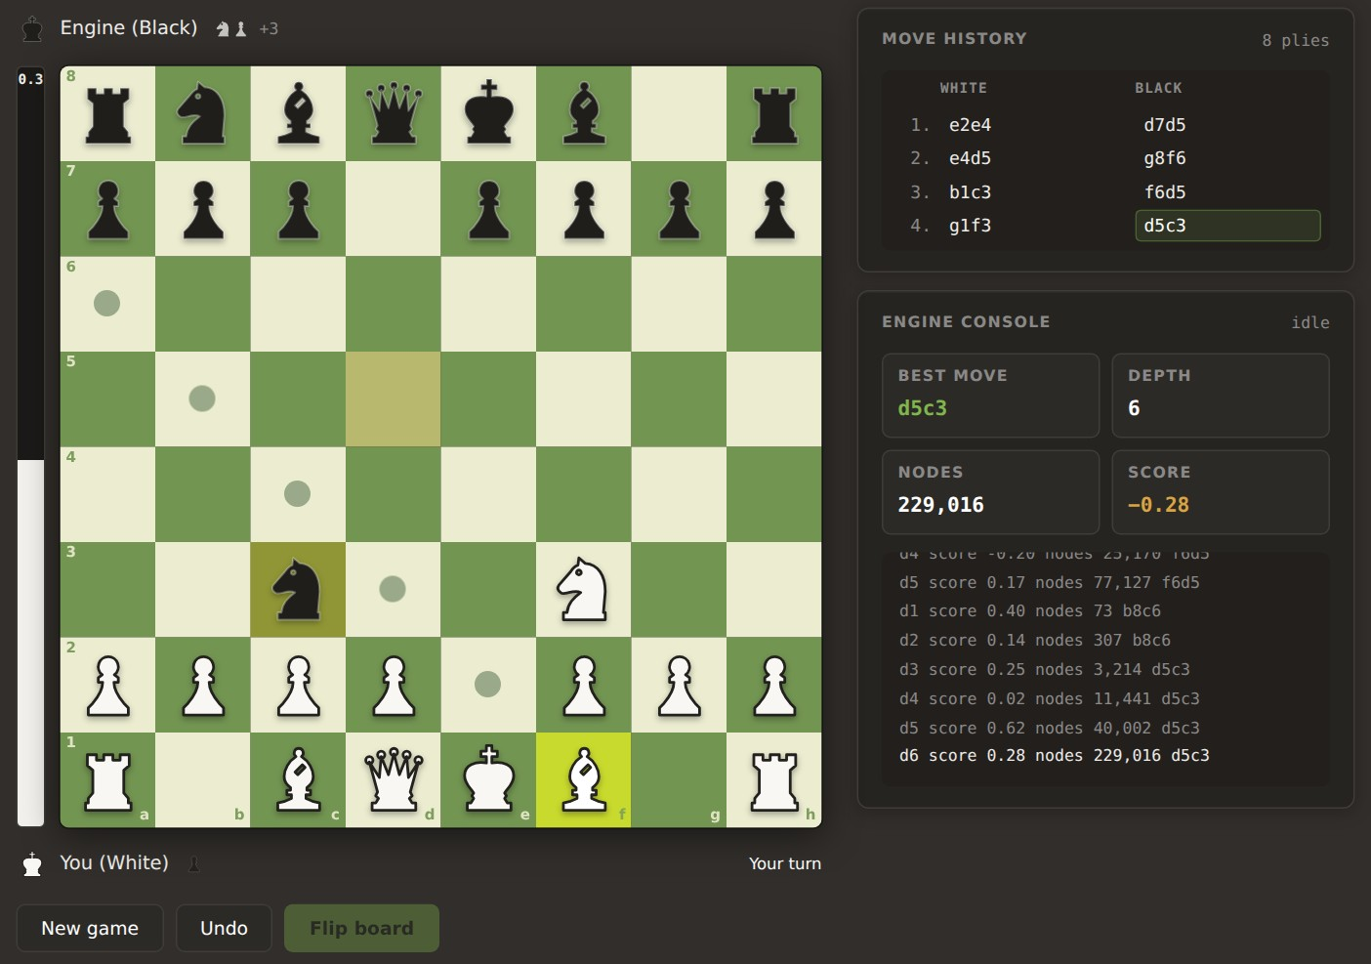
Working Prototype – Play Screen
13
Play either colour; click a piece to see its legal moves; promotion lets you choose the piece.
Live evaluation bar and captured-material lead for each side.
Engine console streams every iterative-deepening pass: depth, score, nodes and best move.
Detects checkmate, stalemate, fifty-move rule, insufficient material and threefold repetition.
Search runs in a Web Worker, so the board never freezes while the engine thinks.
Live: foai-chess-engine.web.app
Code: github.com/SaIdEeVaN/FOAI-Project
Live game against the engine — depth 6, 229,016 nodes and the per-iteration log in a 2 s move.
Department of Cyber Security | Project Review – 1 | 2026–2027

Slide 14
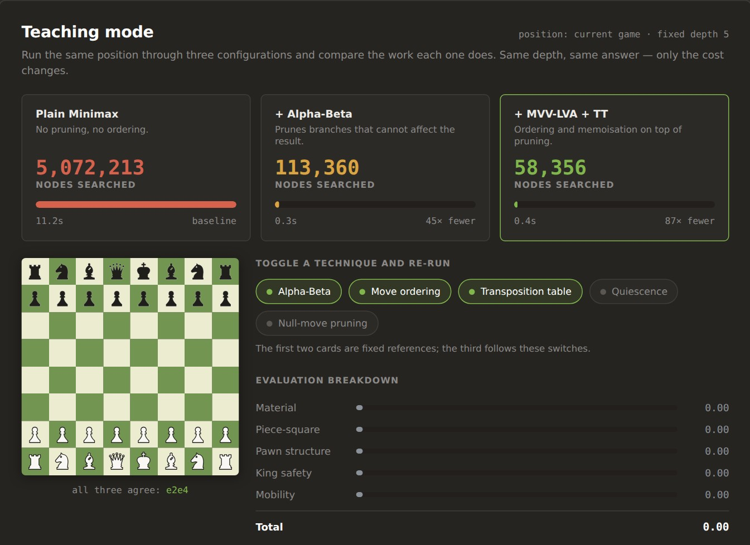
Working Prototype – Teaching Mode
14
Snapshots the current game position and searches it at a fixed depth of 5 under three configurations.
Five techniques toggle independently: Alpha-Beta, move ordering, transposition table, quiescence and null-move pruning.
Reports nodes, time and cost relative to plain Minimax, and checks that every configuration picks the same move.
Breaks the static evaluation into its five terms with signed bars.
A search passing 60 s stops and reports a lower bound (≥) instead of hanging.
Start position, fixed depth 5 — all three configurations agree on e2e4.
Department of Cyber Security | Project Review – 1 | 2026–2027

Slide 15
Preliminary / Expected Results
15
MEASURED ON THE PROTOTYPE
Move generator verified: plain Minimax visits 5,072,213 nodes — exactly Σ perft(0..5) = 1 + 20 + 400 + 8,902 + 197,281 + 4,865,609.
Pruning works: Alpha-Beta needs 45× fewer nodes, and MVV-LVA + TT 87× fewer — with the same move and score.
Fewer nodes ≠ less time: the TT configuration takes 0.77 s vs 0.69 s, because every node pays for a Zobrist hash.
Evaluation tuned: depth-5 plain Minimax fell from 110.2 s to 13.6 s (8.1×) with identical nodes, moves and scores.
In play: ~100k nodes/s, depth 6 in the opening within the 2 s budget; repetition awareness costs only 2–5 %.
45×
87×
e2e4
fewer nodes
with α-β
fewer with
ordering + TT
same move
in all three
Start position, one core. Node counts are exact; timings are from the project README and vary by machine.
Department of Cyber Security | Project Review – 1 | 2026–2027

Slide 16
Project Schedule
16
Activity | Month 1 | Month 2 | Month 3 | Month 4 | Status
Literature Survey | ✓ |  |  |  | Done
Problem Identification & State-Space Formulation | ✓ |  |  |  | Done
System Design & Architecture | ✓ | ✓ |  |  | Done
Implementation (Move Gen, Search, Evaluation) |  | ✓ | ✓ |  | Prototype done
Optimisation, Interface & Deployment |  |  | ✓ |  | Prototype done
Testing, Benchmarking & Final Evaluation |  |  | ✓ | ✓ | In progress
Department of Cyber Security | Project Review – 1 | 2026–2027

Slide 17


Current Progress
17
Literature survey and problem formulation completed
Architecture and core modules defined
7 / 10
Board representation and legal move generator implemented
Negamax α-β search with ID, quiescence, MVV-LVA and Zobrist TT
milestones complete
Move generator validated with perft (exact to depth 5)
React interface and teaching mode built and deployed on Firebase
A working prototype is already live — remaining work is benchmarking, polish and the final evaluation.
Threefold-repetition detection and repetition-aware search
Engine strength benchmarking (Elo / head-to-head)
SAN move notation and FEN entry in teaching mode
foai-chess-engine.web.app
Final evaluation, report and documentation
Department of Cyber Security | Project Review – 1 | 2026–2027

Slide 18
Future Work
18
1
Benchmark playing strength — an Elo estimate from fixed-time matches against reference engines.
2
Add SAN move notation, and FEN entry in teaching mode to compare techniques on sharp tactical positions.
3
Bring null-move pruning into the game search, add a contempt setting for draws and a bounded transposition table.
4
Add an automated test suite — perft on further standard positions alongside the existing start-position check.
5
Extend experiments across positions and depths, and prepare the final report and comparative evaluation.
Department of Cyber Security | Project Review – 1 | 2026–2027

Slide 19



Conclusion
19
The project frames chess as a fully observable, deterministic, zero-sum adversarial state space solved by a goal-based agent.
A from-scratch, interpretable engine — Alpha-Beta, Iterative Deepening, Quiescence, MVV-LVA and a Zobrist TT — is already working and deployed.
Measurements confirm the approach: Alpha-Beta cuts the depth-5 tree 45×, ordering + TT 87×, with the same move — and the plain node count matches perft exactly.
The remaining work is benchmarking, polish and the final evaluation, all without any machine learning.
No machine learning
Pure classical search and heuristics
No external chess library
Rules engine built from first principles
Fully interpretable
Depth, nodes and score shown live
Department of Cyber Security | Project Review – 1 | 2026–2027

Slide 20
References
20
[1] Shannon, C. E. (1950). Programming a Computer for Playing Chess. Philosophical Magazine, Series 7, 41(314), 256–275.
[2] Zobrist, A. L. (1970). A New Hashing Method with Application for Game Playing. Technical Report No. 88, University of Wisconsin.
[3] Knuth, D. E., & Moore, R. W. (1975). An Analysis of Alpha-Beta Pruning. Artificial Intelligence, 6(4), 293–326.
[4] Korf, R. E. (1985). Depth-First Iterative-Deepening: An Optimal Admissible Tree Search. Artificial Intelligence, 27(1), 97–109.
[5] Campbell, M., Hoane, A. J., & Hsu, F. (2002). Deep Blue. Artificial Intelligence, 134(1–2), 57–83.
[6] Coulom, R. (2006). Efficient Selectivity and Backup Operators in Monte-Carlo Tree Search. Computers and Games, LNCS 4630, 72–83.
[7] Russell, S., & Norvig, P. (2020). Artificial Intelligence: A Modern Approach (4th ed.). Pearson – Adversarial Search and Games.
Department of Cyber Security | Project Review – 1 | 2026–2027

